Slide 1

Module 3: Transferring your data to & from CU Boulder Research Computing

Slide 2

Website: www.rc.colorado.edu
Documentation: https://curc.readthedocs.io
Helpdesk: rc-help@colorado.edu
2

Slide 3
Learning Objectives
Ways to access your data
Filesystem structure of CURC resources
Data transfer with OnDemand “Files” application
Data transfer using Globus
Web-based interface
Local Globus endpoint
Connecting local and CURC endpoints

Slide 4
Accessing Data on CURC Resources
When you use CURC resources the data is not on your local machine.
Ways to access/transfer the data from/to your local machine:
Command line (a variety of tools – we won’t cover today)
https://curc.readthedocs.io/en/latest/compute/data-transfer.html
Open OnDemand (straightforward GUI) – files < 1 GB
Globus (GUI with some set up required) – any file size

Slide 5
General Filesystem Structure
/home (2GB)
Small important data Backed up frequently Not for sharing files or job output
PetaLibrary is also available via Globus!
Filesystem documentation: https://curc.readthedocs.io/en/latest/compute/filesystems.html

Slide 6
General Filesystem Structure
/home (2GB) | /projects (250GB)
Small important data Backed up frequently Not for sharing files or job output | Medium sized important data Software Can be shared with others Backed up, but less frequently Not for job output
PetaLibrary is also available via Globus!
Filesystem documentation: https://curc.readthedocs.io/en/latest/compute/filesystems.html

Slide 7
General Filesystem Structure
/home (2GB) | /projects (250GB) | /scratch/alpine (10TB)
Small important data Backed up frequently Not for sharing files or job output | Medium sized important data Software Can be shared with others Backed up, but less frequently Not for job output | Large data Can be shared with others Fast Data transfer to compute nodes Not backed up! Purged after 90 days!
PetaLibrary is also available via Globus!
Filesystem documentation: https://curc.readthedocs.io/en/latest/compute/filesystems.html

Slide 8

GUI option - Open OnDemand
No command line required!
http://ondemand.rc.colorado.edu/
http://ondemand-rmacc.rc.colorado.edu/
File management
Create, Delete, Move, and Rename
File transfers
Upload and Download

Slide 9
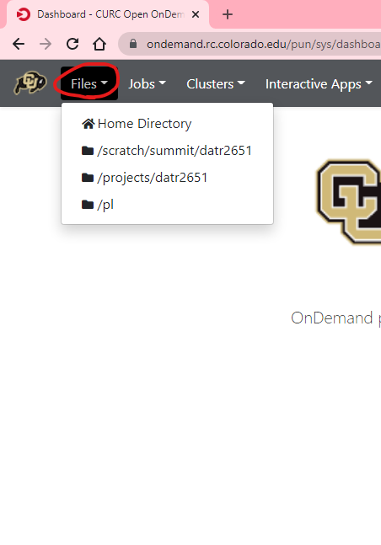
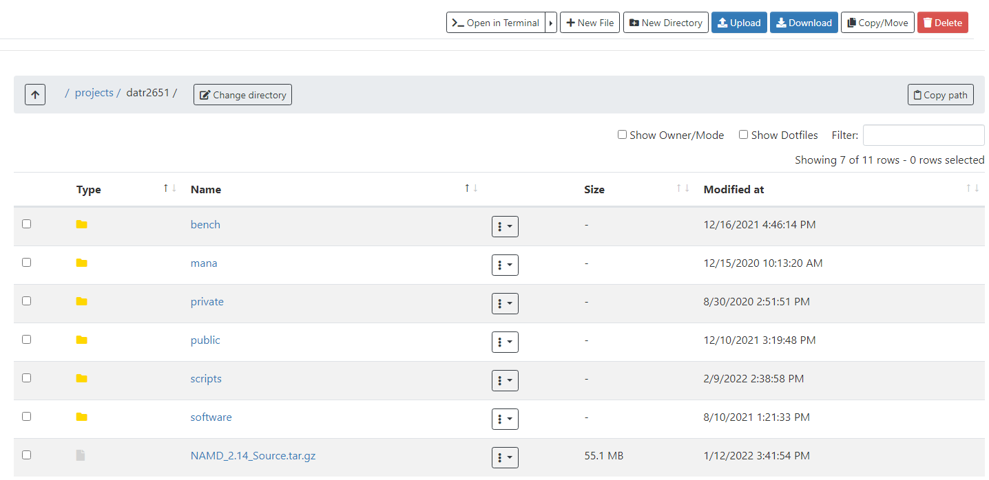
Open OnDemand “Files” Interface

Slide 10

GUI option - Globus
Globus is a service that allows for users to reliably move, share, and discover data
Command line also available
Our recommended way to transfer data
Stable and fast data transfers
Transfers continue if a user disconnects
Web GUI or Globus Connect Personal GUI
Works well with cloud storage providers

Slide 11
Globus Demo
Logging into the web-based interface for Globus
Provides a nice GUI for managing files on CURC resources
Installing a Globus Endpoint on your local machine
Allows you to interact with files on your local machine via Globus

Slide 12
Globus Login to Web-based interface
Navigate to https://app.globus.org
CU Boulder users
Select “University of Colorado at Boulder” in the dropdown menu
CSU users
Select “Colorado State University”
AMC and RMACC users
Select “ACCESS CI (formerly XSEDE)”
Login with your credentials
Continue with onscreen prompts until you are brought to the Globus Web GUI

Slide 13
Globus Web GUI
Let’s take a look!

Slide 14
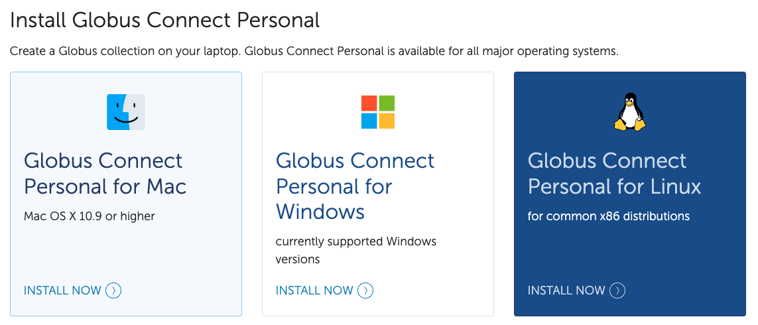
Local Globus Endpoint
Required if you want to transfer data between your machine and CURC resources
Navigate to https://www.globus.org/globus-connect-personal

Slide 15


Local Globus Endpoint-Installed
For “Collection Name” you can use anything name you would like
You will use this as a reference name later, so please remember it!
For Mac and Windows, it is easy to see that Globus has been installed:
For Linux, at the end of the installation, the setup will exit with a message stating it was successfully set up and the main Globus Connect Personal application will launch

Slide 16
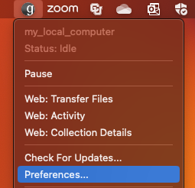
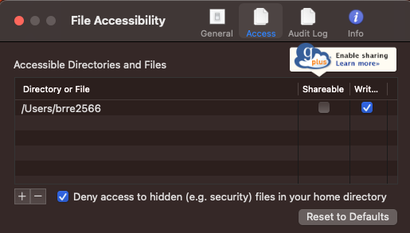
Local Globus Endpoint-Configure
Once the Globus endpoint has been installed on your computer, you then need to configure it.
On Mac and Windows follow the “Configuration” section
On Linux follow the “Running” section
During Configuration you will need to let Globus know what directories or files it can have access to
Select the “Access” tab and add folders you want to be accessible by Globus

Slide 17
Connecting local endpoint to CURC resources

Slide 18

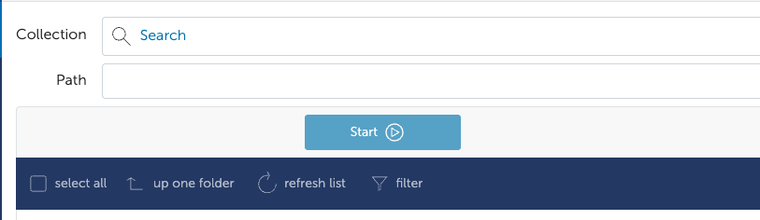
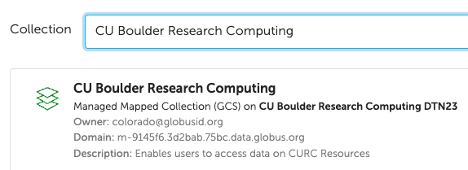
Globus
Step 1: Select “set two pane” in the upper right corner
Step 2: In the left pane click the search bar
Step 3: Search “CU Boulder Research Computing”
Make sure you are using DTN23!

Slide 19
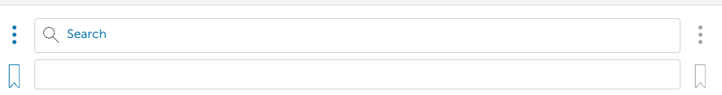
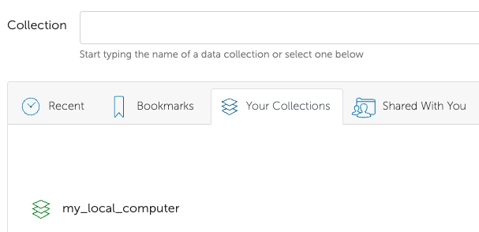
Globus
Step 4: In the right pane, click on “Search”
Step 5: Select the “Your Collections” tab
Step 6: Click the collection name that you chose when you created your local Globus endpoint

Slide 20
Advanced topic: Globus Shared Endpoints
Globus offers ‘shared endpoints’, which allow you to share your data with external collaborators (i.e. you can share data with people who don't have CURC accounts)
CURC provides this capability, however, it is only available for PetaLibrary customers
Shared Endpoints generate a shared collection that can be accessed with a link
For an example, see https://scholar.colorado.edu/concern/datasets/9593tw13k
You can assign various permissions to specific users or all users within Globus
More information is provided at https://docs.globus.org/how-to/share-files/

Slide 21
Review of what we have covered
Ways to access your data
Filesystem structure of CURC resources
Data transfer using Globus
Web-based interface
Local Globus endpoint
Connecting local and CURC endpoints

Slide 22

Any Questions
Notes:
This workshop is meant to be empowering and information-rich – to help you get the most out of your HPC workflow.
Feel free to ask questions during the presentations and to discuss ideas/thoughts during breaks and the hands-on portion of the workshop.

